Slide 1
SMART MEDICINE REMINDER FOR ELDERLY PEOPLE Sravanthi.v Swathi.v

Slide 2
ABSTRACT
Sometimes elderly people forget to take the medicine at the required time of medicines. And sometimes they also forget which medicine they have to take at required time. And it is difficult for Doctor/Compounder/ care takers to monitor patients around the clock. To avoid this problem, we have made this medicine reminder system. An app is build for the user (care taker) which enables him to set the time at which the person has to consume the tablet.

Slide 3
INTRODUCTION
The time that is set is received by our Device Node MCU and stores the data in EEPROM through IP address. LED placed at particular slot will glow and a sound is generated by Buzzer.

Slide 4
COMPONENTS
Hardware
Node MCU
Basic shield
Buzzer
OLED
Connecting wires
SOFTWARE
Arduino
IBM cloud

Slide 5
OVER VIEW
The main idea of project is to first remind the patients to take medicine on time. For this using Node MCU we developed mobile application such we can access and set reminder from anywhere which reminds to take medicines 1 or 2 or 3 times a day

Slide 6
PROJECT HIGHLIGHTS
Explore Node MCU Hardware Platform with analog and digital sensor integration.
Buzzer as soon as the medicine taking time arrives.
OLED’s Specifying which medicine to take on a given time.

Slide 7
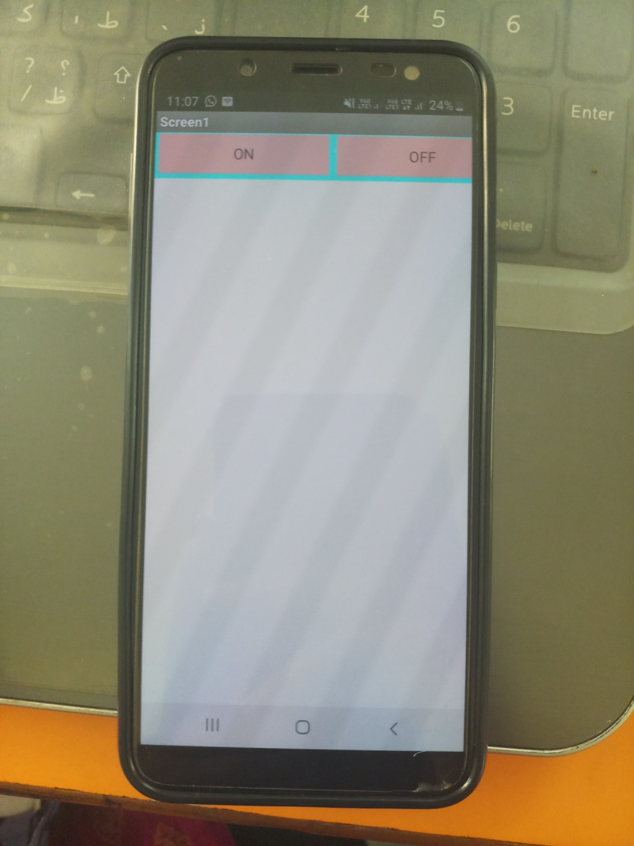

Slide 8
